Slide 1
Bank Management System
Vivekananda Adepu

Slide 2
Abstract
The Bank Account Management System is an application for maintaining a person's account in a bank. In this project I tried to show the working of a banking account system and cover the basic functionality of a Bank Account Management System.
To develop a project for solving financial applications of a customer in banking environment in order to nurture the needs of an end banking user by providing various ways to perform banking tasks.
Also to enable the user’s workspace to have additional functionalities which are not provided under a conventional banking project.

Slide 3
The primary aim of this “Bank Account Management System” is to provide an improved design methodology, which envisages the future expansion, and modification, which is necessary for a core sector like banking.
This necessitates the design to be expandable and modifiable and so a modular approach is used in developing the application software.

Slide 4
System Design: Logical Design
The logical flow of a system and define the boundaries of a system. It includes the following steps:
Reviews the current physical system – its data flows, file content, volumes, frequencies etc.
Prepares output specifications – that is, determines the format, content and frequency of reports.
Prepares input specifications – format, content and most of the input functions.
Prepares edit, security and control specifications.
Specifies the implementation plan.
Prepares a logical design walk through of the information flow, output, input, controls and implementation plan.
Reviews benefits, costs, target dates and system constraints.

Slide 5
System Design: Physical Design
Physical system produces the working systems by define the design specifications that tell the programmers exactly what the candidate system must do. It includes the following steps.
Design the physical system.
Specify input and output media.
Design the database and specify backup procedures.
Design physical information flow through the system and a physical design Walk through.
Plan system implementation.
Prepare a conversion schedule and target date.
Determine training procedures, courses and timetable.
Devise a test and implementation plan and specify any new hardware/software.
Update benefits, costs, and conversion date and system constraints.

Slide 6
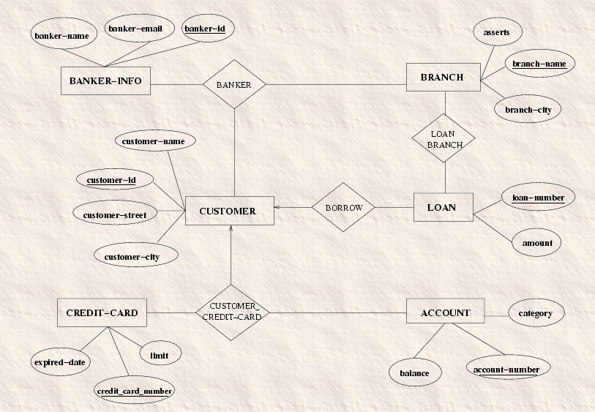
Entity-Relationship Diagram

Slide 7
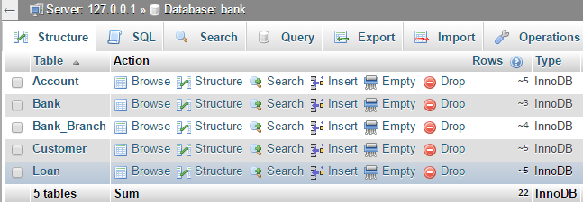
High Level Tables for a Bank

Slide 8
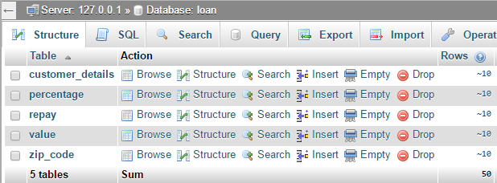
Tables for Mortgage

Slide 9
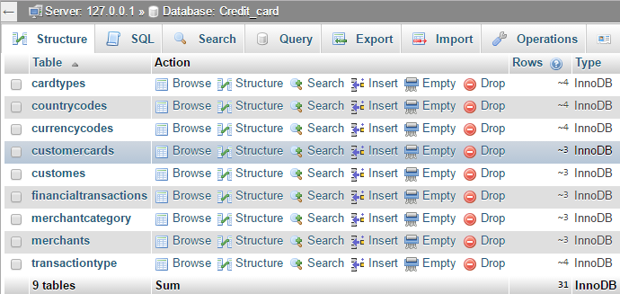
Tables for Credit-Card Processing

Slide 10
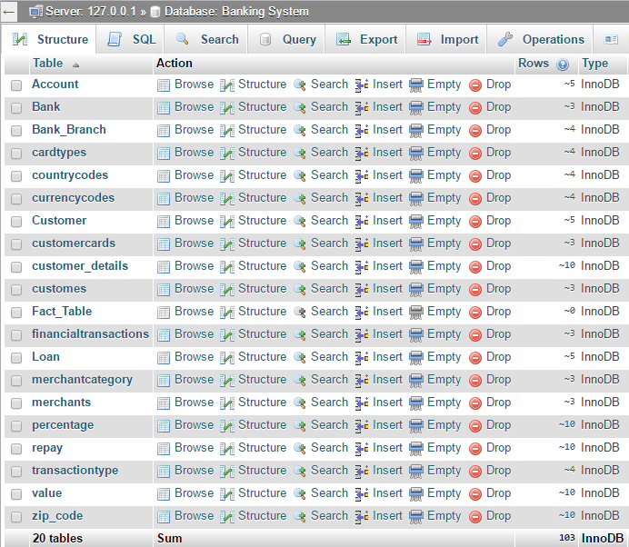
Collaborated Tables in our Data Warehouse

Slide 11
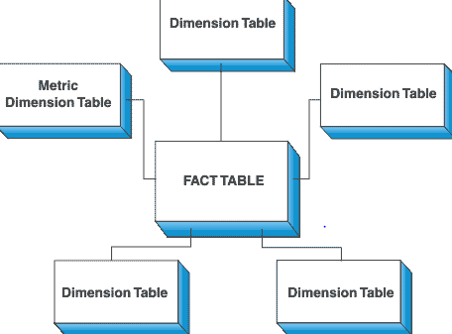
Star Schema
In computing, the star schema is the simplest style of data mart schema and is the approach, most widely used to develop data warehouses and dimensional data marts. The star schema consists of one or more fact tables referencing any number of dimension tables. The star schema is an important special case of the snowflake schema, and is more effective for handling simpler queries.
The star schema gets its name from the physical model's resemblance to a star shape with a fact table at its center and the dimension tables surrounding it representing the star's points.

Slide 12
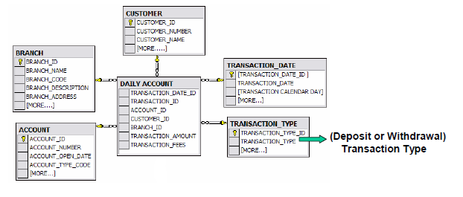
Star Schema for Banking System

Slide 13
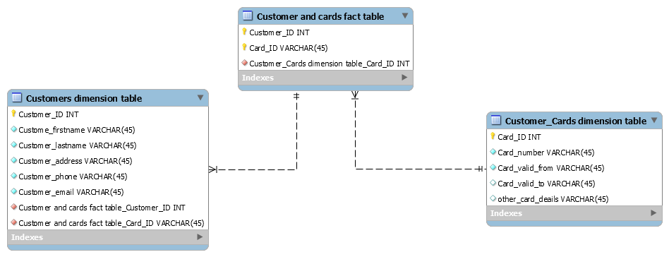

Slide 14
Schema for Banking System
We have chosen Star Schema, which separates business process data into facts, which further hold the measurable, quantitative data about a business, and dimensions which are descriptive attributes related to fact data.
Examples of fact data in our system include account number, customer ID, branch number, loan number, etc. Related dimension attribute examples include type of account, details of customer, bank’s address, type of loan and rate of interest, etc.

Slide 15
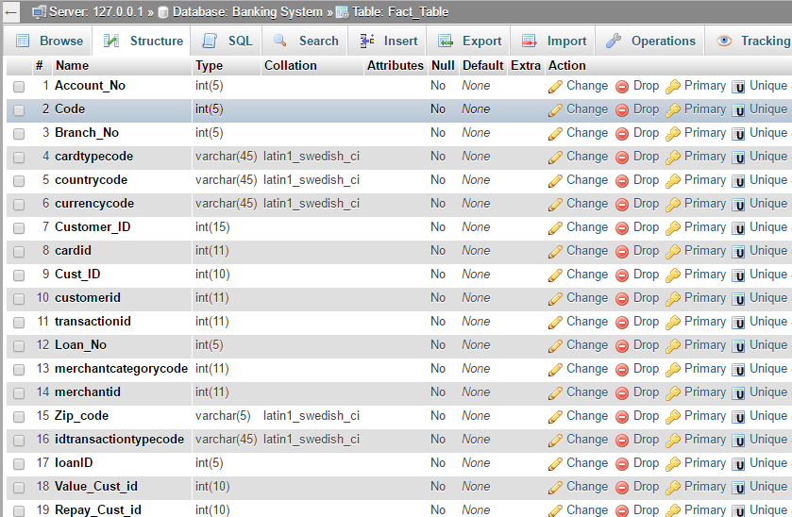
Our Fact Table

